Slide 1
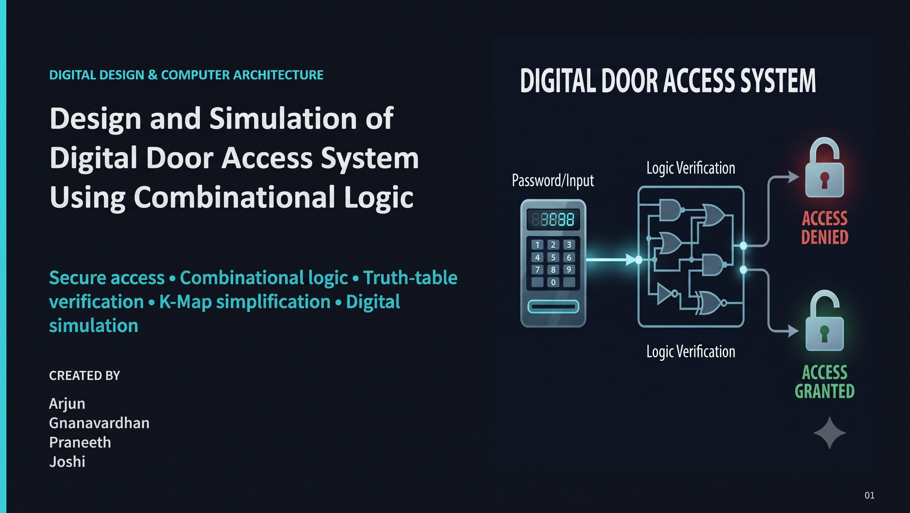

DDCA / DIGITAL ELECTRONICS PROJECT
Design and Simulation of a Digital Door Access System
Using Combinational Logic
Team: Arjun, Joshi, Praneeth, Gnanavardhan
Faculty: Dr. Venkat Isampalli
Roll No: 2620040117, 2620090010, 2620090012, 2620090133
Roll No: 2620040117, 2620090133, 2620090012, 2620090010
Institution: KLH University]
Section: 5

Slide 2
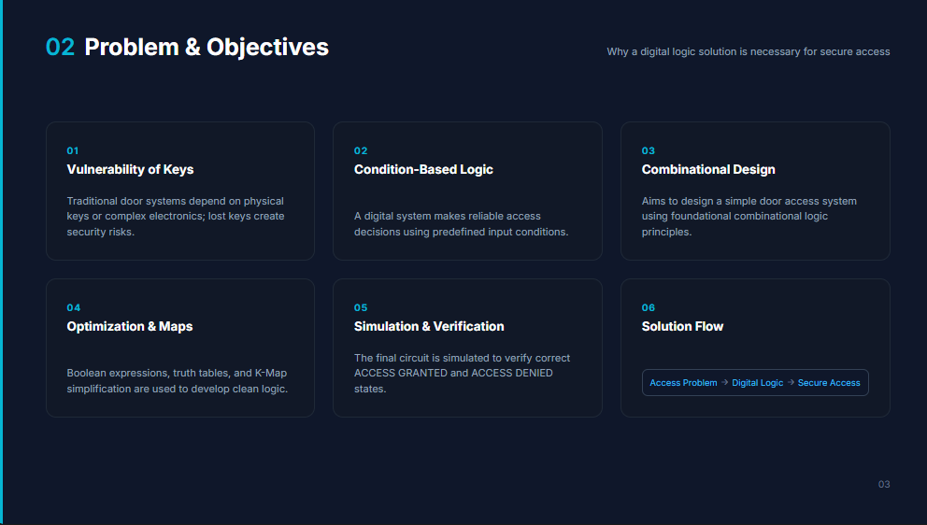

Slide 3


System Overview
Automated access via combinational logic.
Four binary inputs represent distinct security conditions. The system evaluates these inputs simultaneously to output a final access decision.
Four binary inputs.
Input 2 is inverted.
Security Guard Analogy
If every required condition is satisfied, access is granted. If even one condition fails, access is denied.
Evaluated by one AND gate.

Slide 4
Why Combinational Logic?
Combinational Logic
Output depends only on present inputs.
Sequential Logic
Instant response.
No clock required.
Output depends on present inputs and previous states.
No memory needed.
Direct I/O relationship.

Slide 5
System Inputs & Conditions
Binary values dictate states: 1 = Condition Satisfied (HIGH), 0 = Condition Not Satisfied (LOW).
Input 2
Input 1
Input 3
Input 4
0
1
1
1
Requires inversion.

Slide 6



Hardware Components
Four Input Pins
One NOT Gate
Generate 0 or 1 signals representing real-world sensor states.
Performs logical inversion specifically on Input 2.
4-Input AND Gate
Door Access Indicator
Validates all conditions simultaneously. Outputs 1 only if all inputs are 1.
Displays the final logical decision (Access Granted / Denied).

Slide 7
The Role of the NOT Gate
The Reverse Condition
Input 2 (I₂) | NOT Input 2 (I₂')
0 | 1
1 | 0
The required state for Input 2 is 0.
However, the final AND gate requires a HIGH (1) signal to validate a condition.
I₂ = 0 → NOT Gate → 1 → Condition Satisfied.

Slide 8

The Decision Maker: AND Gate
The output is 1 only when A=1, B=0, C=1, and D=1.
In our specific system:
The gate evaluates I₁, I₂', I₃, and I₄. All required conditions must be satisfied simultaneously for access.

Slide 9

Deriving the Boolean Expression
Step 1: Define inputs.
FINAL EXPRESSION
Input 1 → I₁
Input 2 (must be 0) → I₂'
D = Door Access, ' = NOT, · = AND
Input 3 → I₃
Input 4 → I₄
Success Proof: D = 1 · 0 · 1 · 1 = 1

Slide 10
System Truth Table Verification
I₁ | I₂ | I₃ | I₄ | I₂' (Internal) | Door Access (D)
0 | 0 | 0 | 0 | 1 | 0
1 | 0 | 0 | 0 | 1 | 0
1 | 0 | 1 | 0 | 1 | 0
1 | 0 | 1 | 1 | 1 | 1
1 | 1 | 1 | 1 | 0 | 0
0 | 1 | 1 | 1 | 0 | 0
*Showing 6 representative rows out of 16 possible combinations.

Slide 11
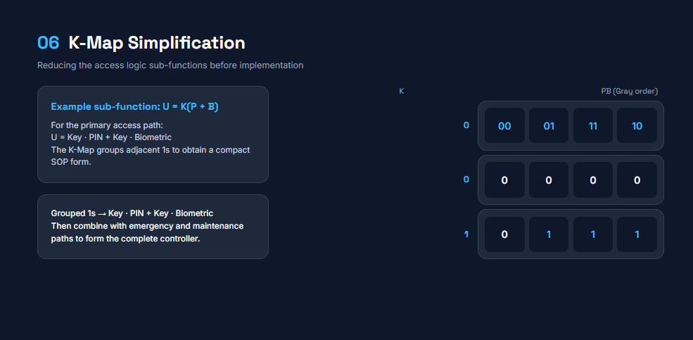

Slide 12
Logisim Implementation Steps
1
Place and label four input components.
2
Place a NOT gate directly after Input 2.
Direct Translation
Expression → Hardware
3
Connect I₁, I₂', I₃, and I₄ to the AND gate.
4
Connect AND output to the Door Access indicator.

Slide 13

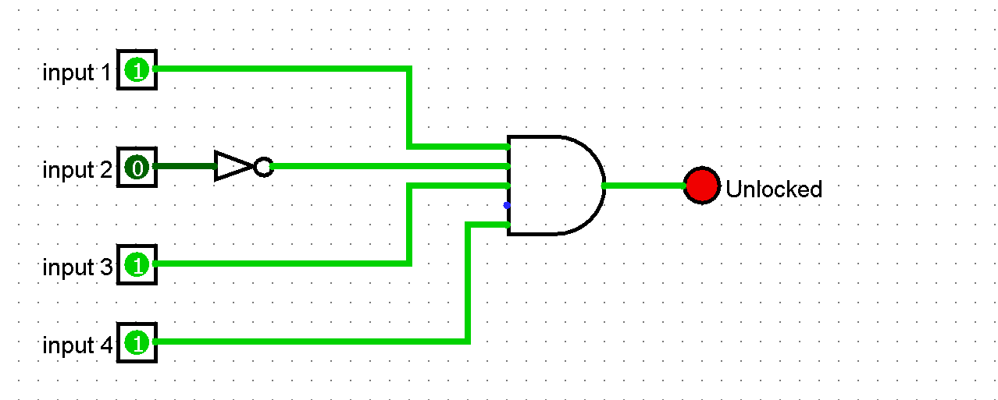
Actual Logisim Circuit Showcase
CURRENT STATE OBSERVATION
Access Granted
The screenshot currently has:
I1 = 1
I2 = 0
I3 = 1
I4 = 1
Door Access = 1

Slide 14
Circuit Testing Results
TEST CASE 1
TEST CASE 2
I: 0 0 0 0
I: 1 0 1 1
D = 0
D = 1
Access denied.
Access granted.
TEST CASE 3
TEST CASE 4
I: 1 1 1 1
I: 1 0 1 0
(I₂' becomes 0)
D = 0
D = 0
Access denied.
Access denied.
Only one specific combination satisfies all four required conditions.

Slide 15
System Architecture Flow
INPUTS
I₁, I₂, I₃, I₄
NOT GATE
Inverts I₂
AND GATE
Evaluates I₁, I₂', I₃, I₄
OUTPUT
Decision
The circuit receives four digital inputs. Input 2 is inverted because its required condition is LOW. The four resulting conditions are then evaluated by the AND gate. Only when every required condition is HIGH does the Door Access output become HIGH.

Slide 16
Design Effectiveness
Key Advantages
Proof of Effectiveness
Simple architecture: Minimal components required.
The circuit is highly effective at implementing the exact access rule defined by the Boolean expression. Its reliability is proven by the truth table and validated through Logisim simulation testing.
Fast response: Instantaneous propagation delay.
No clock required: Operates purely on state changes.
Easy troubleshooting: Direct input-to-output relationship.
Educational clarity: Clearly demonstrates Boolean logic.

Slide 17
Limitations & Future Scope
Current Limitations
Future Enhancements
× Fixed access conditions.
+ Keypad, RFID, or Biometric integration.
× No user identification/authentication.
+ Microcontroller integration for dynamic rules.
× No password storage or database.
+ LCD/OLED status display interfaces.
× No event logging or invalid-attempt alarms.
+ Sequential logic for temporary access states.
× Not suitable as a complete commercial system.
+ IoT monitoring and remote management.

Slide 18

Project Conclusion
4 Inputs + 1 NOT Gate + 1 AND Gate = Access Decision
This project demonstrates that even a practical security decision can be represented, verified, and simulated using fundamental combinational logic.
Thank You

